Slide 1

Learning Python
2020/10/12

Slide 2
IMPORTANT NOTE:
Do not share this file.
Do not redistribute this file.
Do not sell this template.
Do not share the code with anyone. Let others follow the mechanics on YouTube for them to get this template.
If you have spare time, please leave a comment on YouTube that you already downloaded the file. Your simple words of appreciation will motivate me to create more free templates.
PYTHON LIST

Slide 3

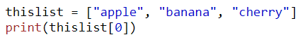
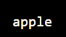


List
List are used to store multiple items in a single variable
List are one o the 4 built-in data types in python used to store collections of data, the other 3 are Tuple, Set, and Dictionary, all with different qualities and usage.
List are created using square brackets:

Slide 4

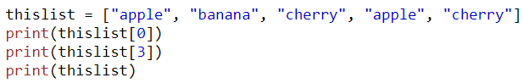

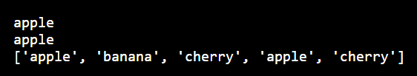
Changable
The list is changeable, meaning that we can change, add, and remove items in a list after it has been created.
Allow Duplicates
Since lists are indexed, lists can have items with the same value:

Slide 5
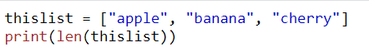
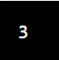
List Lenght
To determine how many items a list has, use the len() function:

Slide 6
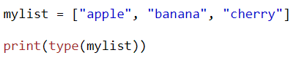
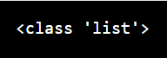
Type()
From python’s perspective, list are defined as objects with the data type ‘list’.

Slide 7
IMPORTANT NOTE:
Do not share this file.
Do not redistribute this file.
Do not sell this template.
Do not share the code with anyone. Let others follow the mechanics on YouTube for them to get this template.
If you have spare time, please leave a comment on YouTube that you already downloaded the file. Your simple words of appreciation will motivate me to create more free templates.
ACCESS LIST ITEMS

Slide 8

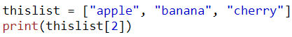
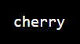
Access Items
List items are indexed and you can access them by referring to the index number:

Slide 9


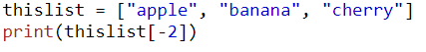
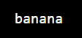
Negative indexing:
Negative indexing means start from the end -1 refers to the last item, -2 refers to the second last item etc.

Slide 10
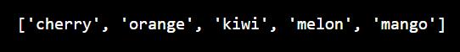
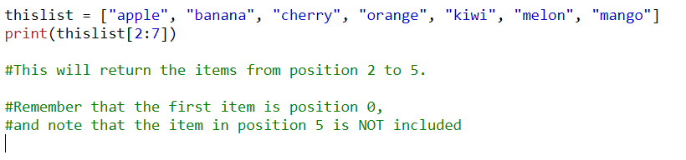
Range of Indexes
You can specify a range of indexes by specifying where to start and were to end the range.
When specifying a range, the return value will be new list with specified items.

Slide 11
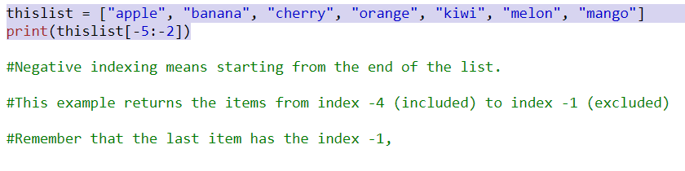
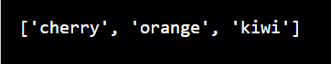
Rage of Negative Endexes:
Specify negatives indexes if you want to start the search from the end of the list:

Slide 12

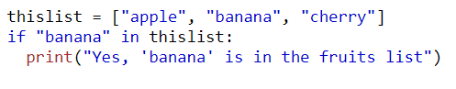
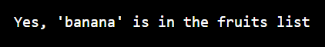
Check if Items Exists:
To determine if a specified item is present in a list use the in keyword:

Slide 13
IMPORTANT NOTE:
Do not share this file.
Do not redistribute this file.
Do not sell this template.
Do not share the code with anyone. Let others follow the mechanics on YouTube for them to get this template.
If you have spare time, please leave a comment on YouTube that you already downloaded the file. Your simple words of appreciation will motivate me to create more free templates.
CHANGE LIST ITEMS

Slide 14
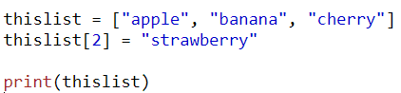
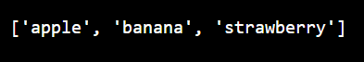
Change Item Value:
To change the value of a specific item, refer to the index number:

Slide 15
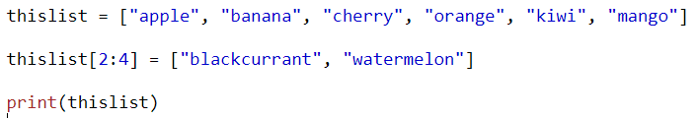
Change a Range of Item Values
To change the value of items within a specific range, define a list with the new values, and refer to the range of index numbers where you want to insert the new values:

Slide 16
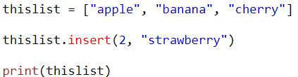
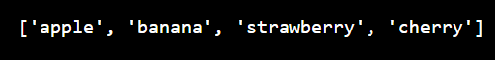
Insert Items:
To insert a new list item, without replacing any of the existing values, we can use the insert() method
The insert() method inserts an item at the specified index:

Slide 17
IMPORTANT NOTE:
Do not share this file.
Do not redistribute this file.
Do not sell this template.
Do not share the code with anyone. Let others follow the mechanics on YouTube for them to get this template.
If you have spare time, please leave a comment on YouTube that you already downloaded the file. Your simple words of appreciation will motivate me to create more free templates.
ADD LIST ITEMS

Slide 18
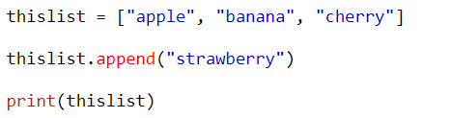
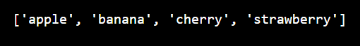
Append Items:
To add an item to the end of the list, use the append() method:

Slide 19
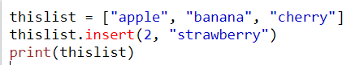
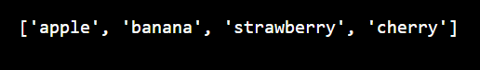
Insert Items
To insert a list item at a specified index, use the insert() method.
The insert() method inserts an item at the specified index:

Slide 20
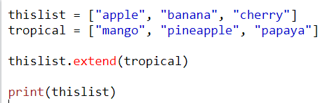
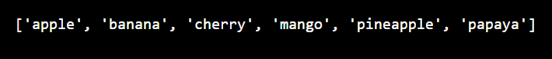
Extend List:
To append elements from another list to the current list, use the extend() method.

Slide 21
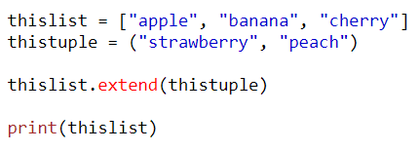
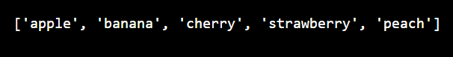
Add Any Iterable:
The extend() method does not have to append list, you can add any iterable object(tuples, sets, dictionaries etc.)

Slide 22
IMPORTANT NOTE:
Do not share this file.
Do not redistribute this file.
Do not sell this template.
Do not share the code with anyone. Let others follow the mechanics on YouTube for them to get this template.
If you have spare time, please leave a comment on YouTube that you already downloaded the file. Your simple words of appreciation will motivate me to create more free templates.
REMOVE LIST ITEMS

Slide 23
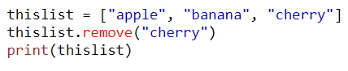
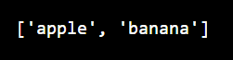
Remove Specified Item
The remove() method removes the specified item.

Slide 24

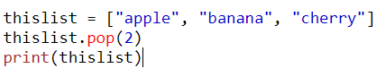
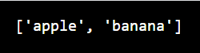
Remove Specified Index
The pop() method removes the specified index

Slide 25
Remove Specified Item
The remove() method removes the specified item.

Slide 26
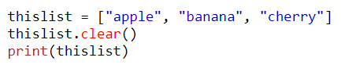
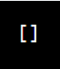
Clear the List
The clear90 method empties the list
The list still remain, but it has no content.

Slide 27
IMPORTANT NOTE:
Do not share this file.
Do not redistribute this file.
Do not sell this template.
Do not share the code with anyone. Let others follow the mechanics on YouTube for them to get this template.
If you have spare time, please leave a comment on YouTube that you already downloaded the file. Your simple words of appreciation will motivate me to create more free templates.
PYTHON- SORT LISTS

Slide 28

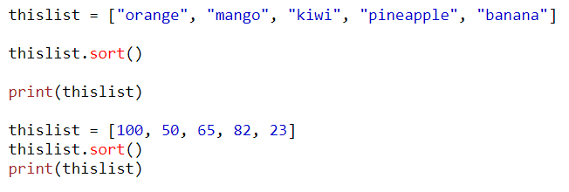
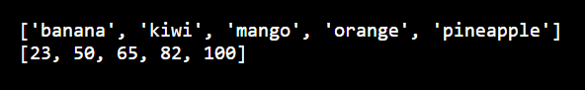
Sort List Alphanumerically
List object have a sort() method that will sort the list alphanumerically, ascending, by default:

Slide 29
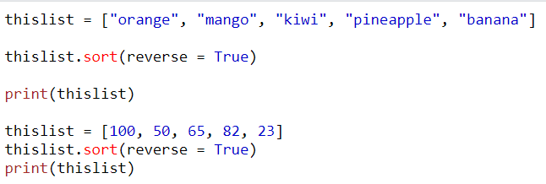

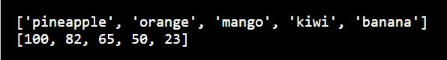
SORT DESCENDING
To sort descending, use the keyword argument reverse= True:

Slide 30
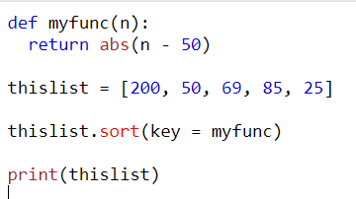
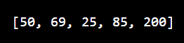
CUSTOMIZE SORT FUNCTION
You can also customize your own function by using the keyword argument key = function.
The function will return a number that will be used to sort the list(the lowest number first);

Slide 31
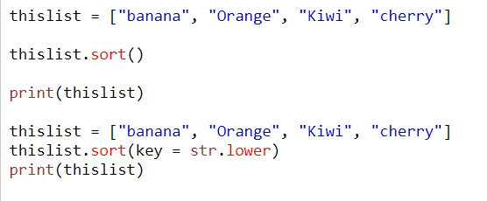
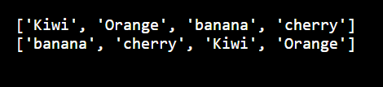
Case Insensitive Sort
By default the sort() method is case sensitive, resulting in all capital letters being sorted before lower case letter:

Slide 32
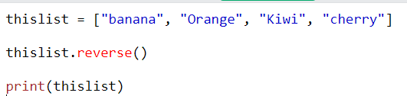
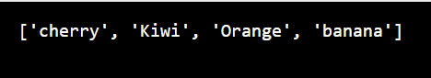
Reverse Order
What if you want to reverse the order of a list, regardless of the alphabet?
The reverse() method reverse the current sorting order of the elements.

Slide 33
IMPORTANT NOTE:
Do not share this file.
Do not redistribute this file.
Do not sell this template.
Do not share the code with anyone. Let others follow the mechanics on YouTube for them to get this template.
If you have spare time, please leave a comment on YouTube that you already downloaded the file. Your simple words of appreciation will motivate me to create more free templates.
PYTHON-COPY LIST

Slide 34
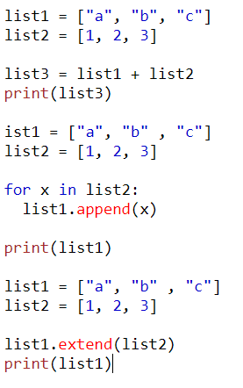
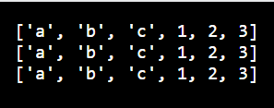
Join Two List
There are several ways to join, or concatenate, two or more list in Python.
One of the easiest ways are by using the + operator.

Slide 35
IMPORTANT NOTE:
Do not share this file.
Do not redistribute this file.
Do not sell this template.
Do not share the code with anyone. Let others follow the mechanics on YouTube for them to get this template.
If you have spare time, please leave a comment on YouTube that you already downloaded the file. Your simple words of appreciation will motivate me to create more free templates.
PYTHON LIST

Slide 36
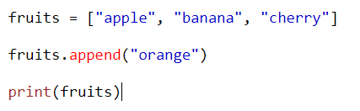

Append() Method
The append() method appends an element to the end of the list.

Slide 37


Clear() Method
The clear() method removes all the elements from a list.

Slide 38


Copy() Method
The copy() method returns a copy of the specified list.

Slide 39


Count() Method
The count() method returns the number of elements with the specified value.

Slide 40


Extend() Method
The extend() method adds the specified list elements(or any iterable) to the end of the current list.

Slide 41


Index() Method
The index() methods return the position at the first occurrence of the specified value.

Slide 42


Insert() Method
The insert() method insert the specified value at the specified position.

Slide 43


Pop() Method
The popo() method removes the element at the specified position.:

Slide 44


Remove() Method
The remove() method removes the first occurrence of the element with the specified value.

Slide 45


Reverse() Method
The reverse() method reverses the sorting order of the elements.

Slide 46


Sort() Method
The sort() method sorts the list ascending by default.

Slide 47
IMPORTANT NOTE:
Do not share this file.
Do not redistribute this file.
Do not sell this template.
Do not share the code with anyone. Let others follow the mechanics on YouTube for them to get this template.
If you have spare time, please leave a comment on YouTube that you already downloaded the file. Your simple words of appreciation will motivate me to create more free templates.
HOMEWORK-EXERCISES

Slide 48


Python List Remove()
The remove() method removes the first matching element(which is passed as an argument) from the list

Slide 49


Ex. 1-Remove element from the listt

Slide 50


Ex. 2: Remove() method on a list having duplicate elements

Slide 51


Ex.3: Deleting element that doesn’t exist

Slide 52

THANK YOU
CHINESE NAME: 錢德羅
STUDENT ID: 4110E216
ENGLISH NAME: Chandro S. Ermitanio
EMAIL: chandroermitanio95@gmail.com
GITHUB: https://github.com/4110e216/cs2022.git

